Slide 1

Unit 1:- Electric and Hybrid Powertrain Technologies
By:- Prof. Dr. Saket Yeolekar

Slide 2
Syllabus…Unit 1 Focus On….
Lecture | Topics to be covered
L1 | Introduction to vehicles, IC engine & Battery Electric Vehicles (BEV’s) , history and social importance
L2 | Benefits of E vehicles, Types of E-vehicles on the basis of propulsion devices, Energy sources and energy carriers.
L3 | PEV’s & HEV’s , BEV, HEV, FCEV, UCEV and UFEV
L4 | Classification of HEV, Micro hybrid, mild hybrid, full hybrid, plug-in hybrid and range extended hybrid electric vehicle.
L5 | Parallel hybrid, Series Hybrid, Power split and compound Hybrid Configuration Plug-in Hybrid Electric Vehicles (PHEV’s),
L6 | Hybrid Hydraulic vehicles (HHV),Pneumatic Hybrid Vehicles, (PHVs)
L7 | Power/Energy Management System

Slide 3
Lecture 6
Series Hybrid
Series Hybrid Advantages
Series Hybrid Disadvantages
Parallel Hybrid Drivetrain
Parallel Hybrid
Parallel Hybrid Single-Shaft
Parallel Hybrid Double-shaft
Operating Modes Parallel Hybrid
Advantages of Parallel Hybrid
Disadvantages of Parallel Hybrid
Series-Parallel Hybrid
Operating Mode : Series-parallel Hybrid

Slide 4
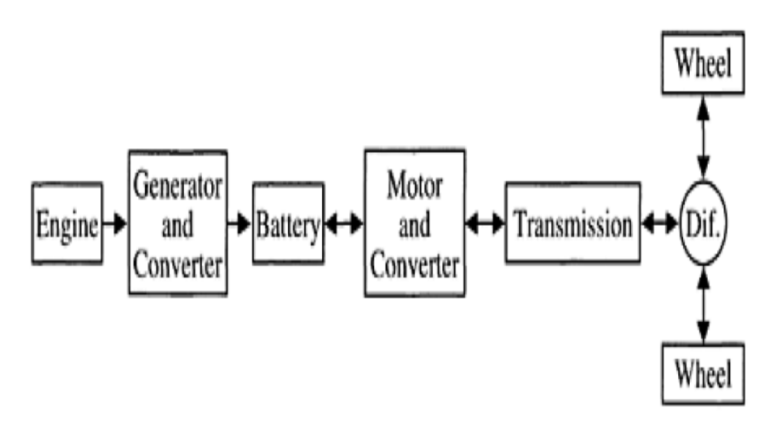
Series Hybrid ….

Slide 5
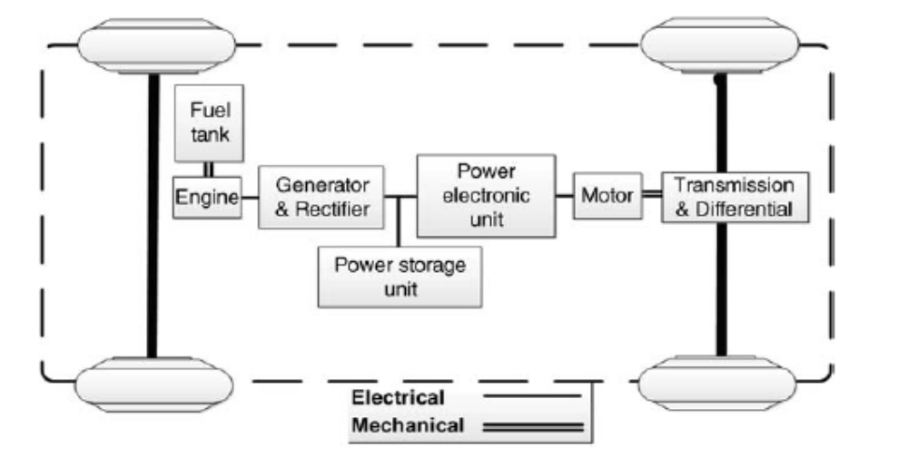
Series Hybrid ….

Slide 6
Series Hybrid Advantages….
A series hybrid is one in which only one energy converter can provide propulsion power. The heat engine or ICE acts as a prime mover in this configuration to drive an electric generator that delivers power to the battery or energy storage link and the propulsion motor.
Advantages
1. Flexibility of location of engine-generator set
2. Simplicity of drivetrain
3. Suitability for short trips
4. Simplicity of control algorithms used to control the power converters, hence achieving smooth speed control of electric motors

Slide 7
Series Hybrid Disadvantages….
1. It needs three propulsion components: ICE, generator, and motor.
2. The motor must be designed for the maximum sustained power that the vehicle may require, such as when climbing a high grade. However, the vehicle operates below the maximum power most of the time.
3. All three drivetrain components need to be sized for maximum power for long-distance, sustained, high-speed driving.
This is required, because the batteries will exhaust fairly quickly, leaving ICE to supply all the power through the generator.

Slide 8
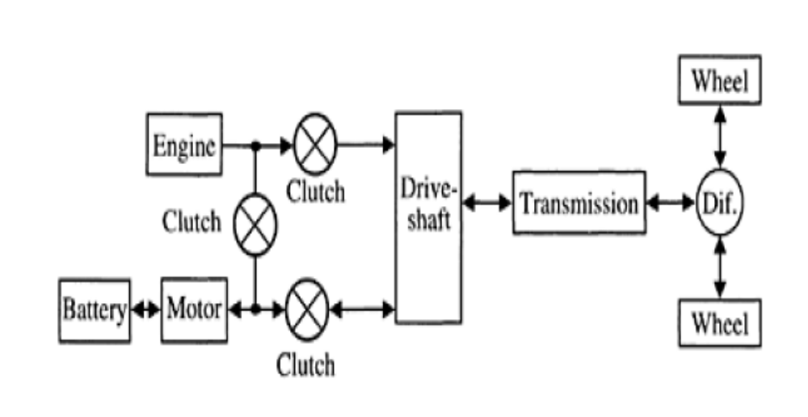
Parallel Hybrid Drivetrain ….
Parallel Hybrid Drivetrain

Slide 9
Parallel Hybrid….
Parallel hybrid configuration is the most popular configuration in HEVs. This configuration mechanically couples the mechanical and electrical powers, allowing their use either simultaneously or independently.
Usually, in parallel hybrid powertrains, the mechanical and electrical power outputs are combined by using mechanical devices such as torque-couplers and speed couplers.
A mechanical torque-coupler adds the torques of the combustion engine and the electric motor using a gearbox unit or a pulley/chain assembly.
In contrast, speed-couplers can be in the form of a planetary gear unit, they combine the combustion engine and electric motor powers. An electric motor with a floating stator can work as a speed-coupler as well.

Slide 10
Parallel Hybrid….
The main benefit of hybrid powertrains with speed-couplers over those with torque couplers is the decoupled speeds of the two power plants, granting the opportunity to choose the speed of both the power plants independently.
In a parallel hybrid arrangement, it is possible to shut off the ICE and only run the electric motor from the battery pack (as in a full electric vehicle).
The ICE has the ability to recharge the battery during less intense power driving cycles, thereby making it more efficient for highway driving than the stop–start conditions of city driving.

Slide 11
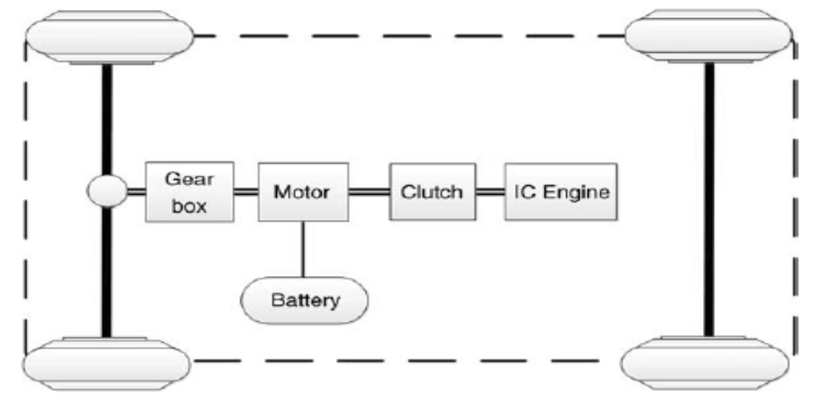
Parallel Hybrid Single-Shaft….
Parallel Single-Shaft Hybrid Powertrain

Slide 12
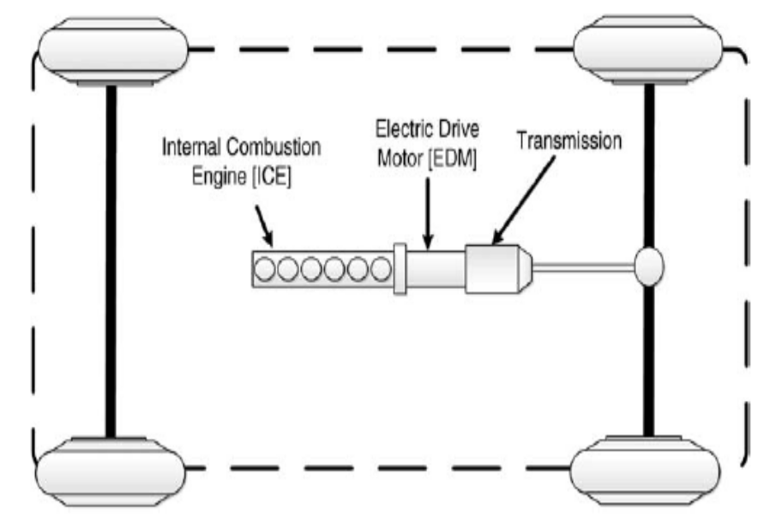
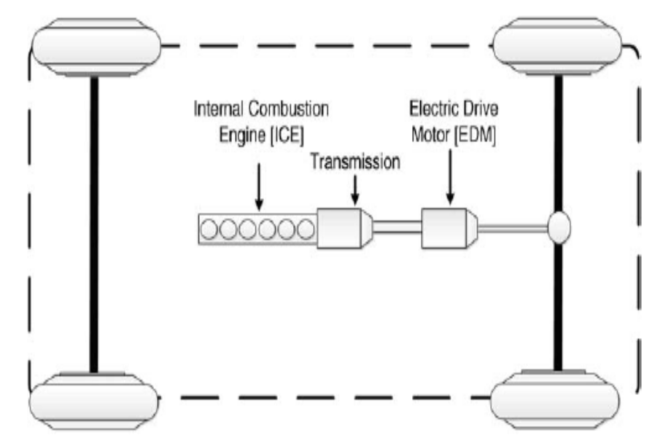
Parallel Hybrid Single-Shaft….
Pre-transmission parallel
hybrid Powertrain
Post-transmission parallel hybrid Powertrain

Slide 13
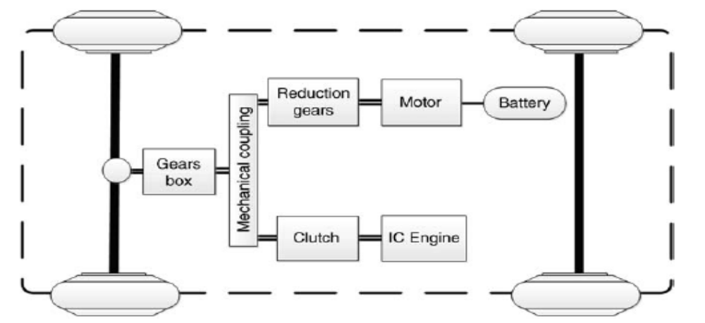
Parallel Hybrid Double-shaft ….
Double-shaft parallel hybrid powertrain

Slide 14
Operating Modes Parallel Hybrid ….
Engine-alone traction mode: In this mode, the combustion engine generates the total required power for vehicle motion while the motor is off. This mode is used when the engine is running at or near its optimal operating conditions, such as when cruising.
Electric-alone traction mode: In this mode, the engine is off and the electric source supplies the total required power for vehicle motion. This mode is on when the ICE efficiency is low, such as when starting the vehicle, or when the vehicle speed is low (e.g., during reverse gear).
Hybrid mode: In this mode, the wheels receive power from both power sources. This mode is activated in conditions requiring more power such as when accelerating or during high speed driving.

Slide 15
Operating Modes Parallel Hybrid ….
Engine traction and battery charging mode: In this mode the power generated by the ICE is more than the power required for vehicle motion. In this case, the additional power recharges the battery by switching the electric motor to operate as a generator.
Regeneration mode: In this mode, the kinetic energy the vehicle wastes while braking, or during downhill motion recuperates through the regenerative system of the powertrain.
Some of the parallel hybrid vehicles in the market are the Chevy Malibu Hybrid, the Honda Insight, the Ford Escape Hybrid, and the Honda Civic Hybrid.

Slide 16
Advantages of Parallel Hybrid ….
1. It needs only two propulsion components: ICE and motor/generator. In parallel HEV, the motor can be used as the generator and vice versa.
2. A smaller engine and a smaller motor can be used to get the same performance, until batteries are depleted.
For short-trip missions, both can be rated at half the maximum power to provide the total power, assuming that the batteries are never depleted.
For long-distance trips, the engine may be rated for the maximum power, while the motor/generator may still be rated to half the maximum power or even smaller.

Slide 17
Disadvantages of Parallel Hybrid ….
The control complexity increases significantly, because power flow has to be regulated and blended from two parallel sources.
The power blending from the ICE and the motor necessitates a complex mechanical device.

Slide 18
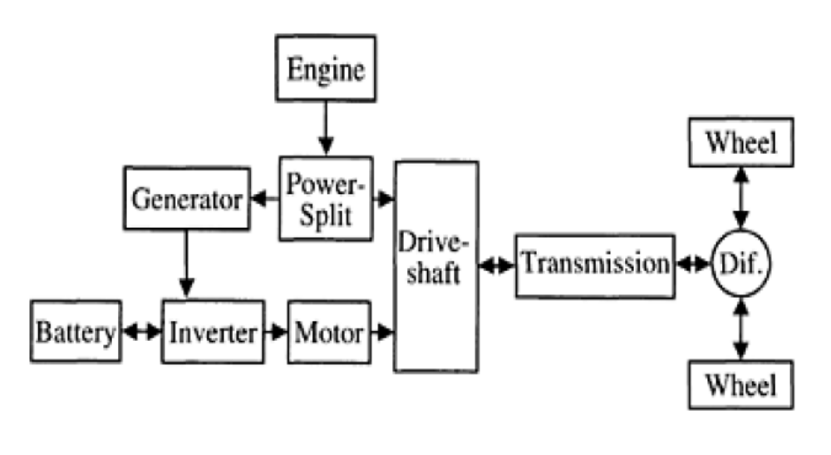
Series-Parallel Hybrid ….

Slide 19
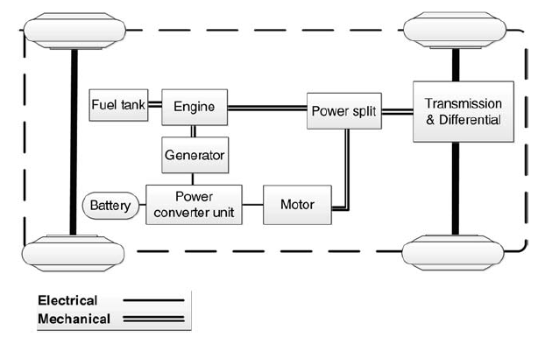
Series-Parallel Hybrid ….

Slide 20
Series-Parallel Hybrid ….
Series-parallel hybrid systems takes advantage of the best features of both series and parallel hybrids
In comparison with a parallel hybrid powertrain, a series-parallel uses an additional electric motor that primarily functions as a generator
On the other hand, when compared to a series hybrid powertrain, the series-parallel connects the engine to the final drives through a mechanical link, thus allowing the engine to drive the wheels directly
Systems split the power from the engine between two paths: one transfers the power to the wheels through a mechanical gear system, and the other transfers the power to the wheels through a generator and an electric motor.
The example is of the Toyota Prius hybrid design.

Slide 21
Operating Mode : Series-parallel Hybrid ….
There are two groups of a series-parallel hybrid powertrain in operating mode of a series-parallel hybrid powertrain: ICE-heavy and electric-heavy.
The operation mode of ICE-heavy is similar to that of a parallel hybrid, in which the engine is more active than the electric motor.
The operation mode of electric-heavy is similar to that of a series hybrid powertrain, in which the electric traction motor is more active than the engine.
It uses a power split device to effectively combine the engine driving power and the motor driving power.
A planetary-geared, electrically controlled, continuous variable transmission (E-CVT), and magnetic continuous variable transmission (M-CVT) are the main devices used to combine the powers.

